Slide 1
Senior MF Fabric

Slide 2
Large lakehouse optimization
Lakehouse with 10b + row optimization
Commun issues
Report 2 to 5 min to load
Timeout during business hours
Capaciy spikes to 95%
Possible root causes :
No Partition strategy
No Delta Optimization
No Shorcuts
Direct lake misused
Poor data model (with bidirectional relationships…)
Inspection
Check capacity metrics
Review query history
Inspect Delta table structure
Analyze data model
Some typical fix actions
Lakehouse
Run OPTIMIZE + ZORDER on delta tables
Enable V-Order
Compact small files
Sementic model
Convert snowflake to star model
Remove bi-directional filters
Use aggregated tables
Enable incremental refresh
Architecture adjustment
Move heavy model to warehouse
Use composite model
Splits semantic model by domain
How to interpet the capacity metrics
CPU usage
Refreshing dashboard , runing notebooks , pipelines , scheduling semantics refresh at the same time (parallelism or workload concurenncy saturation) can cause CPU spikes to 95% → refresh dashboard durring the working hours , and all other run move to night
Memory pressure
If memory stays > 80% constantly, possible causes are Large direct lake model , too many columns, large cardinality columns , poor model design. If direct lake model = 1,2 TB this can cause memory pressure at 85% and slowdown reports. This model is spilling(deborder) to disk and Direct Lake advantage is lost.
Query duration
Long running queries , example : Most query run in 2 seconds and 5% is running = 90 sec ; Possible a heavy Dax measure is killing the performence . Possible solution are Pre-aggrgate on source side , optimised relatioships
Background vs interactive operation
Background → Refresh , pipelines ,notebooks and Interactive → User queries (PBI) ,
when backgroud = 70% and Interactive = 20% users will complain report are slow so push as mush as possible background operation to the night.
Throttling
MS fabric is delaying or rejecting request because capacity is overloaded, when 120 throttling between 9-10 AM , Capacity exceeded safe CPU threshold repeatedly then report will slowdown , model refresh will fail. Possible Solutions are reduce concurences ,optimize DAX , use aggregated tables, upgrade to hight capacity
Overload events
This a bad signal meaning capacity could not serve request in time. Exampe Overload spikes during month-end closing , capacity need to be tempoary scale up during the peak , or scale up to a higher capacity if the issue persists.

Slide 3
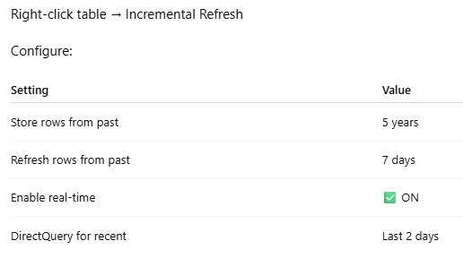
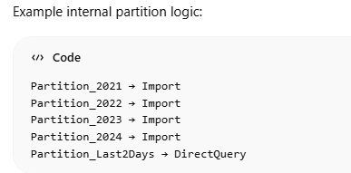
Incremental (hybrid) data refreh
Incremental refresh in MS Fabric
In Ms fabric incrementl refesh is ONLY at semantic model level using Date field with date data type use of Rangstart and rangEnd technical variables making sure the query folding is support by source system. Configuaration policy must include example store from last 5 years – fresh from last 7 days , Enable Detect data changes (optional but recommanded)
When the target table has a field like lastModifiedDate the Configuaration policy can only be based on this to refresh only when lastModifiedDate got updates
Fabric supports hybrid incremental refrech this is used for near realtime dashboarding
Historical data --→ Import mode
Last Data --→ DirectQuery
In fabric the polowing configuaration will enable the hybrid incremental refresh , meaning old data (historical) will be in import mode and recent data with Direct Query

Slide 4
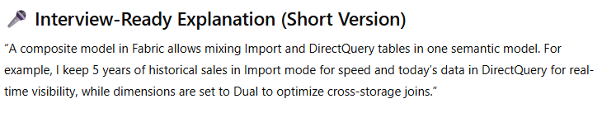
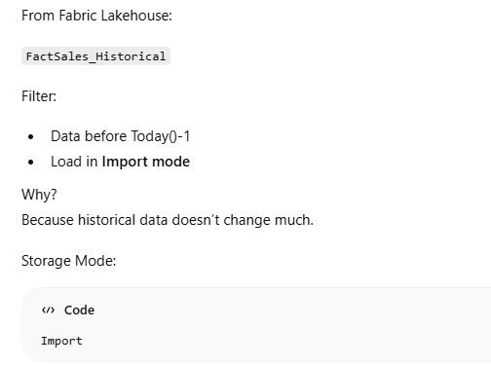
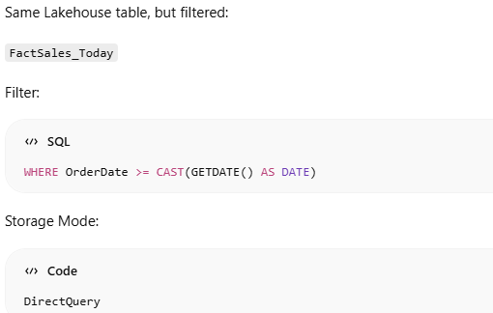
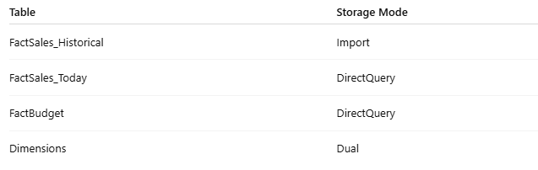
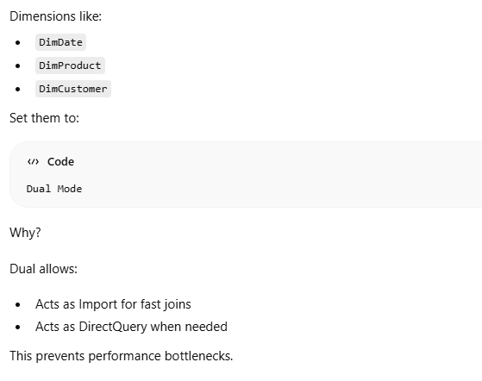
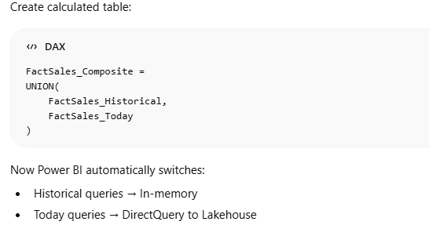
Composite data model in MS Fabric
In MS Fabric the same fact table can use both storage mode to suppot the repoting , this called a composite data model
Creating the historical table in Power bi
Creating the real time table in Power bi
Combining these 2 table in PBI

